Slide 1

Path Plan Algorithm
03/08/2017

Slide 2
Introduction
The goal of the path plan is returning the best path under constraints of run time and shortest distance.
The path plan consist of two main parts:
- Building a directed graph of all possible paths.
- Scan the tree for the best path.

Slide 3
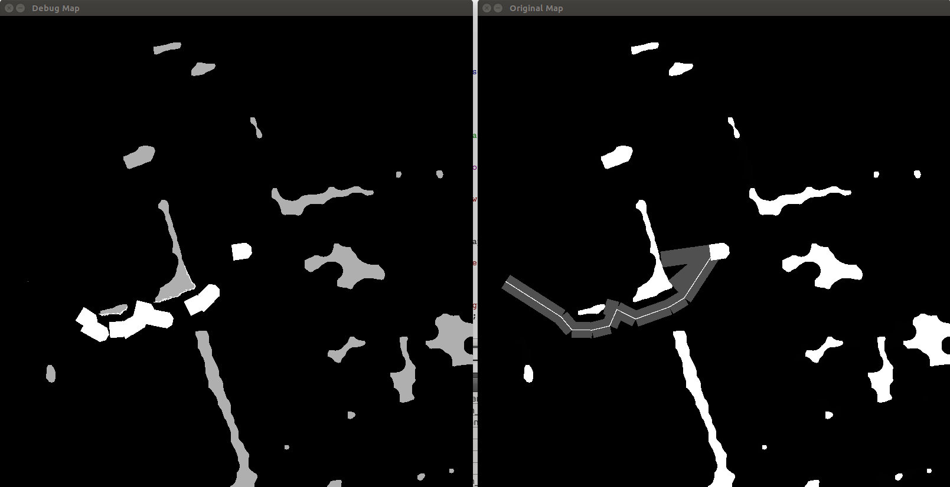
Introduction
Demonstration of the path plan.
Two OpenCV images that the right one represent how the best path is returned by the algorithm.

Slide 4
Generally describing the algorithm
1. Try to reach the destination.
2. If there is hitting point (with an obstacle then
  Suggest a new place for the robot from
  right and left sides of the
  obstacle in order to bypass it.
  Define the new robot’s places as destinations and try to reach them (repeat from step 1 on the new destinations).
3. From all available paths suggest the
one with the shortest distance.

Slide 5
Collision DAG – Why we need it?

Slide 6
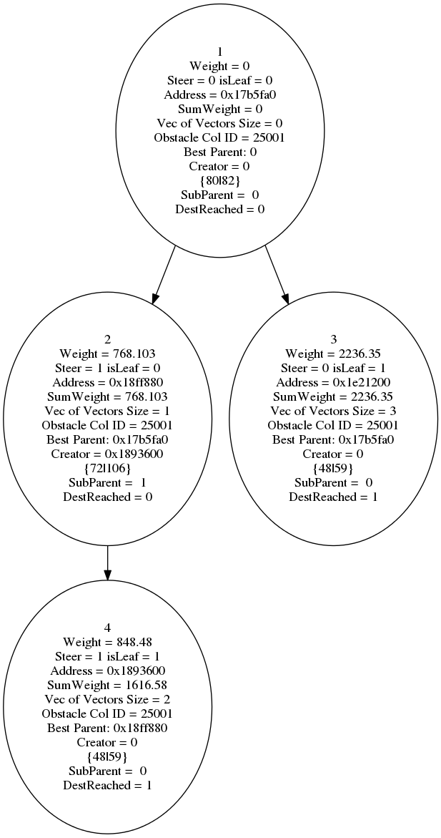
Definitions
DAG – Directed Acyclic Graph, Each edge in graph G has a direction in one
way. There are no circles in graph.
Vector beam – Beam that starts from robot body with the same
width as the robot.
Collision – When the vector Beam hit an obstacle (in OpenCV
matrix obstacles are defined by some threshold).
Forward propagation – a beam vector toward the overall
destination.
Backward propagation – a beam vector toward tail of suggested
robot location.

Slide 7
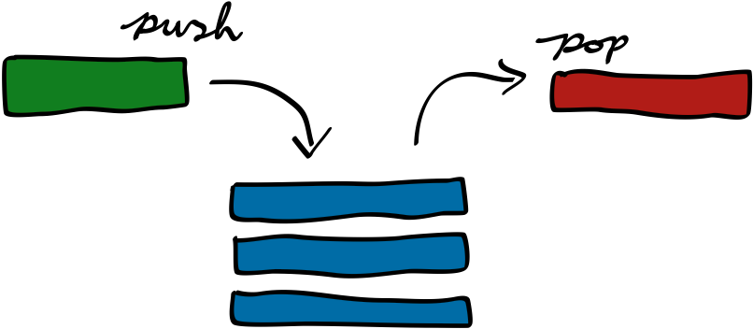
Definitions
Stack – Data structure, pushing in and popping out elements.
The rule is LIFO – Last in First out.

Slide 8

Flow
Receive destination (x,y)
Creating Beam Vector
from robot to destination
Scanning for collision
on beam vector that at the
head of the stack
Collision
Stores beam vector to
current node in DAG
of collisions
Suggests new place for
robot and push two
new beam vectors to the
stack
(beam vectors that bypass
the current obstacle)

Slide 9
Representing the collisions
Each time that there is a collision the original
beam vector is broken into two new sub beam vectors.
The sub vectors actually suggest new way to pass the obstacle and also will be pushed to the stack to be checked for hitting point.
BUT!!! we don’t have any registration of these beam vectors.
In addition
the vectors that passed the hit check successfully (no hit occurred) should be stored in a data structure in such way that at the end of the path planning process the best path will be pulled out in minimum time and best weight.

Slide 10
DAG – representing the collisions
There are two kinds of beam vectors:
- Those with aim to the final destination which will be called forward vectors.
- Those with aim to a suggested robot position.
Suggested
Point left
Backward
Obstacle
Forward
Teamy
Destination
Forward
Backward
Forward
Suggested
Point right

Slide 11
DAG – representing the collisions
What will be happen if there are collisions both on forward and backward beams?
How to represent those collisions and where save the new suggested vectors?
Suggested
Point left
Backward
Obstacle
Forward
Teamy
Destination
Forward
Ob
Forward
Backward
Ob
Suggested
Point right
Suggested
Point right
Suggested
Point right

Slide 12
DAG – representing the collisions
Each beam vector that was defined as forward beam will cause the current node in the DAG to split into two new children.
Each beam vector that was defined as backward beam will cause the current node in the DAG to switch his current parent with couple of parents nodes: Left parent and Right parent.
Original
parent
Current
Node
Backward
Forward
Parent left
Parent right
Left child
Right child
Current
Node

Slide 13
DAG – representing the collisions
The DAG supports both cases of forward and backward and allows quick pull of the lightest path by DFS or BFS scans.
The DAG saves redundant duplications that were needed if binary tree was the data structure that we have worked with.
Original
parent
Current
Node
Backward
Forward
Parent left
Parent right
Left child
Right child
Current
Node

Slide 14
Dilation and Erosion

Slide 15
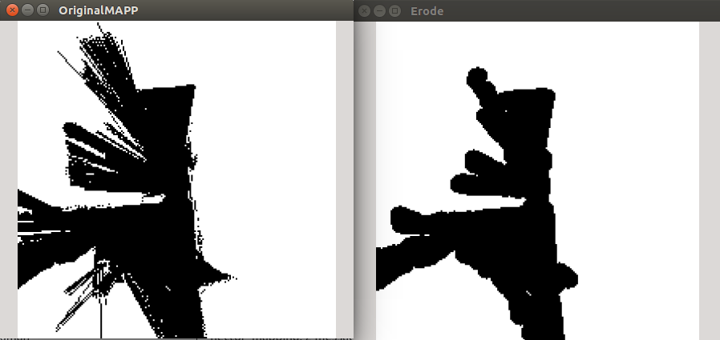
Dilation and Erosion
In order to smooth the obstacles and unifying separated obstacles that the distances between them are smaller than robot size.
After dilation and erosion

Slide 16
Crescent shapes – Solution

Slide 17
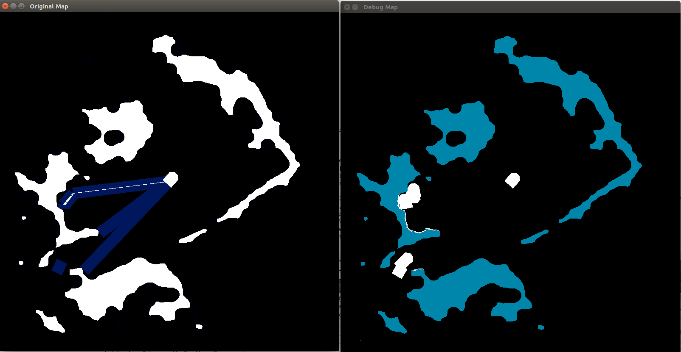
Crescent shapes
Repeated problem that had been seen in demos and simulations was bypassing obstacles with crescent shape:

Slide 18
Crescent shapes
Solution: After finding new point on the contour of the obstacle check the beam from the point to destination.
If the beam hits the same obstacle again and the hit point was already visited at the current bypassing iteration, (mark the contour vector elements that had been checked) then skip the new point and continue the iteration over the contour.
At this place the green arrow points to destination lays totally in free space.
Here we are about to suggest a new robot position, But before we will perform 1 more check.
Dest

Slide 19
Crescent shapes
Dest
1. Creating a
new vector points to destination and
check for collisions with the same object ID
2. Check if this pixel (point) was already visited in former iteration by scanning the contour vector inside range of elements that had been visited.
3. If point is existed then
skip this pixel to the next
Contour vector

Slide 20
Future tasks, problems to solve and questions

Slide 21
Future tasks
- Improve the suggested robot’s positions due to collision.
- Improve the code of iterating over obstacle surface by using OpenCV
contours method.
- Optimization of the code (memory and running time).
- Combine between the global map and the local map.
- Obstacles are formed from a line of pixels (related to robot’s position).
-

Slide 22
Questions?

Slide 23
Thank you

